Slide 1

Domain: MATLAB
Technology: COMMUNICATION
A NEW CHANNEL ESTIMATION TECHNIQUE FOR 5G MIMO COMMUNICATION SYSTEMS

Slide 2
Index
Abstract
Introduction
Literature review
Existing Method
Disadvantages
Proposed method
Advantages
Applications
Hardware and Software Requirements
Results
Conclusion
References

Slide 3
Abstract
One of the key areas where Internet of Things (IoT) is facilitating the use of numerous transmitters on board and enabling the use of Multiple Input Multiple Output (MIMO) systems for improved communications is the health care sector. It can be difficult to use 5G MIMO systems with quality of performance (QoP) that are appropriate for IoT applications. For 5G MIMO wireless communication systems for IoT applications, a training symbol-based channel estimation approach is defined, proposed, and studied in this study. For refining the proposed channel estimator, an M-estimator is recommended. Comparing simulation results with Least Squares (LS) channel estimation with and without Discrete Fourier Transform allows for an evaluation of the suggested technique's performance (DFT).
Keywords: ECG Biometric, Authentication

Slide 4
Introduction:
Existing cellular networks face numerous practical challenges as a result of the exponentially increasing demand for higher data rates and the rapidly expanding number of mobile users. These networks must also develop in order to meet the demands of the upcoming 5G networks by having a high network capacity and wide area coverage. The main drawbacks of current networks are their low data rates, minimal quality of experience (QoE), poor end-to-end performance, limited indoor coverage, and subpar mobility performance, which prevents them from offering services like high spectral efficiency, large network capacity, wide spectrum availability, low latency, and low energy consumption. The 5G MIMO communication system needs plans for spectral efficiency enhancement, scheduling for channel information, coding, and adaptive modulation in order to meet both of the specified goals. All of these strategies require correct channel state information, or CSI, which is available at the transmitter end.

Slide 5
Literature review:
S. NO | Journal Type with year | Authors | Title | Outcomes
1 | IJRTE, vol. 8, pp. 1776-1778, 2019.. | T. Anil Kumar, Sk Nilofer and R. Sahithi | “Channel estimation techniques for OFDM and UFMC systems for 5G communications,” | Studied about Channel estimation techniques for OFDM and UFMC systems for 5G communications.
2 | IEEE Transactions on Wireless Comm., vol. 9, no. 11, pp. 3590-3600, 2010. | T. L. Marzetta, | “Noncooperative cellular wireless with unlimited number of base station antennas,” | Studied about the Noncooperative cellular wireless with unlimited number of base station antennas.
3 | Engineering Journal, vol. 20, 2015. | R. K. Saha, P. Saengudomlert and C. Aswakul | , “Evolution toward 5G mobile networks – A survey on enabling technologies,” | Studied about the Evolution toward 5G mobile networks – A survey on enabling technologies.
4 | J. Wireless Communications and Mobile Computing, pp.1-8, 2019. | Imran Khan et.al | “A robust channel estimation scheme for 5G massive MIMO systems,” | Studied about the A robust channel estimation scheme for 5G massive MIMO systems.
5 | IJPAM, vol. 118, No. 19, 2018. | G. Rajender, T. Anil Kumar and K. Srinivasa Rao | “Empirical Analysis of Channel Estimation Procedures with Enhanced Kalman Filter Algorithm over MIMO-OFDM Environment,” | Studied about the Empirical Analysis of Channel Estimation Procedures with Enhanced Kalman Filter Algorithm over MIMO-OFDM Environment.

Slide 6
Existing method:
This method proposed, pilot-assisted techniques for channel estimation (CE) are simulated for Universal Filtered Multi-Carrier (UFMC) modulation scheme. UFMC aims at replacing orthogonal frequency division multiplexing (OFDM) and improves performance and robustness in the case of time frequency misalignment. These techniques efficiently support Internet of Things (IoT) and massive machine type communications (mMTC), which are identified as challenges for 5G wireless communication systems (WCS). Pilot-aided techniques are adopted and applied to OFDM and UFMC. Simulation results are supplemented to compare the performance of UFMC systems with conventional CP-OFDM systems. The flow of the proposed method is shown in figure below:

Slide 7
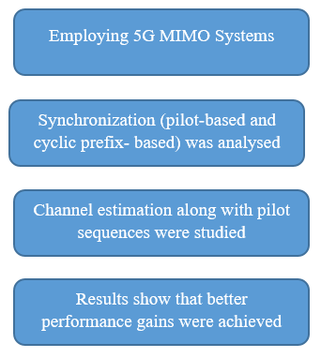
Existing method:
Fig: Block Diagram of Existing Method

Slide 8
Disadvantages in Existing methods:
Need more parameters for the implementation.
Requires high cost.
Difficult to implement.

Slide 9
Proposed method:
In simulations, channel estimation using LS and Proposed M-estimator (with and without DPT) based techniques are compared and shown in Fig. FFT size is 32 and pilot spacing is 4. For improving the performance of channel estimation technique a DFT-method is been developed by suppressing noise effect outside of the maximum channel delay which is shown in simulations. From the simulation results, an observation is done on the proposed method for channel estimation (with and without DFT) as closely approximation of true channel in both the cases.

Slide 10
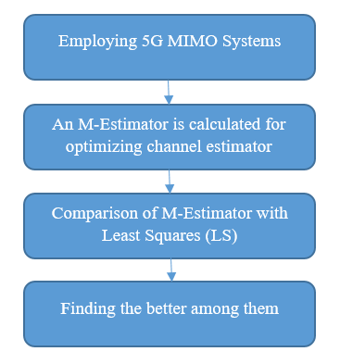
Proposed method:
Fig: Block diagram of Proposed method

Slide 11
Advantages of Proposed method:
1.Gives the better results of channel estimation.
2.Less complex than the Least Squares (LS) Method.

Slide 12
Applications:
There are numerous applications for the use of Biometric Technology, but the most common ones are as follows:
5G MIMO
5G MISO
Channel Estimations

Slide 13
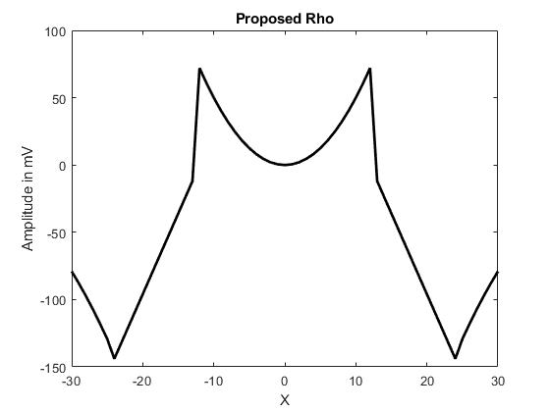
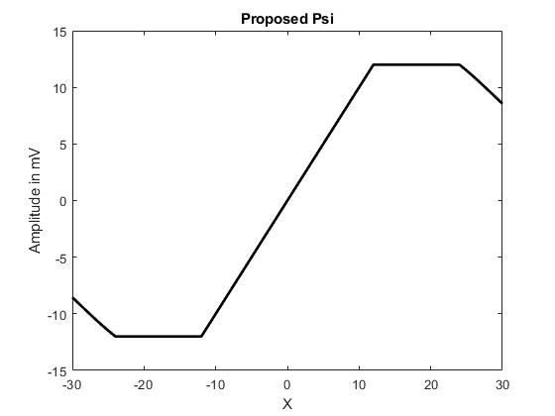
Results:

Slide 14
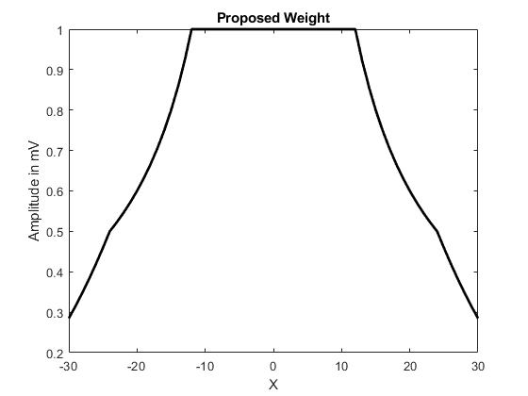
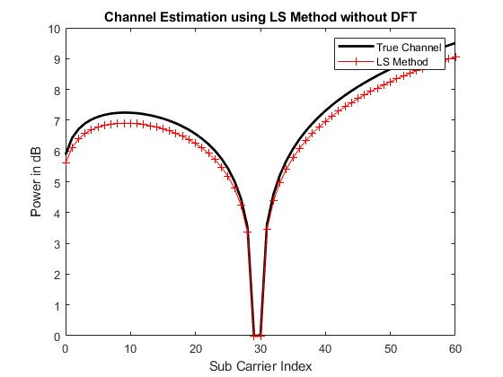
Results:

Slide 15
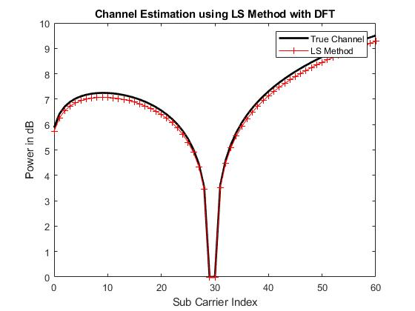
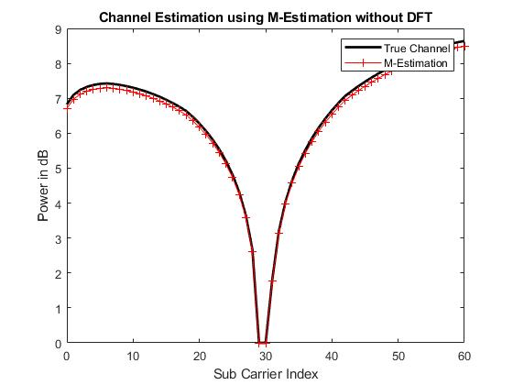
Results:

Slide 16
Results:

Slide 17
conclusion:
Robust training symbol based channel estimation for 5G wireless communication systems using M-estimation is proposed and studied in this paper. An M-estimator is proposed and used for optimizing the channel estimation technique. Simulation results are also provided to support efficacy of the proposed study of channel estimation in 5G wireless communication systems with additive white Gaussian noise. From simulation results, it is concluded that the proposed technique closely approximates true channel estimation for 5G MIMO wireless communication system with and without DFT.

Slide 18
Hardware and Software Requirements:
Hardware & Software Requirements:
Software: Matlab R2018a.
Hardware:
Operating Systems:
• Windows 10
• Windows 7 Service Pack 1
• Windows Server 2019
• Windows Server 2016
Processors:
Minimum: Any Intel or AMD x86-64 processor
Recommended: Any Intel or AMD x86-64 processor with four logical cores and AVX2 instruction set support
Disk:
Minimum: 2.9 GB of HDD space for MATLAB only, 5-8 GB for a typical installation
Recommended: An SSD is recommended a full installation of all Math Works products may take up to 29 GB of disk space
RAM:
Minimum: 4 GB
Recommended: 8 GB

Slide 19
References:
[ I.] Y. Li, L. J. Cimini and N.R. Sollenberger, “Robust channel estimation for OFDM systems with rapid dispersive fading channels,” IEEE Trans. Comm., vol. 46, pp. 902-915, 1998.
[ II] F. R. Hampel, E. M. Ronchetti, P. J. Rousseeuw, and W. A. Stahel, Robust Statistics: The Approach Based on Influence Functions, Wiley, New York, 1986.
[ III.] T. Anil Kumar and K. Deergha Rao, “A New M-estimator Based Robust Multiuser Detection in Flat-fading Non-Gaussian Channels,” IEEE Trans. Comm, vol. 57, no. 7, pp. 1908-1913, 2009.
[IV] Michel Saideh, Marion Berbineau and Iyad Dayoub, “On the performance of Sliding Window TD-LMMSE Channel Estimation for 5G Waveforms in High Mobility Scenario,” IEEE Trans. Vehicular Technology, Vol. 67, No.9, pp. 8974- 8977, Sept 2018.
[V.] O. E. Ijiga, “Review of channel estimation for candidate waveforms of next generation networks,” J. Electronics, Vol. 8, pp. 1-50, 2019.

